Slide 1
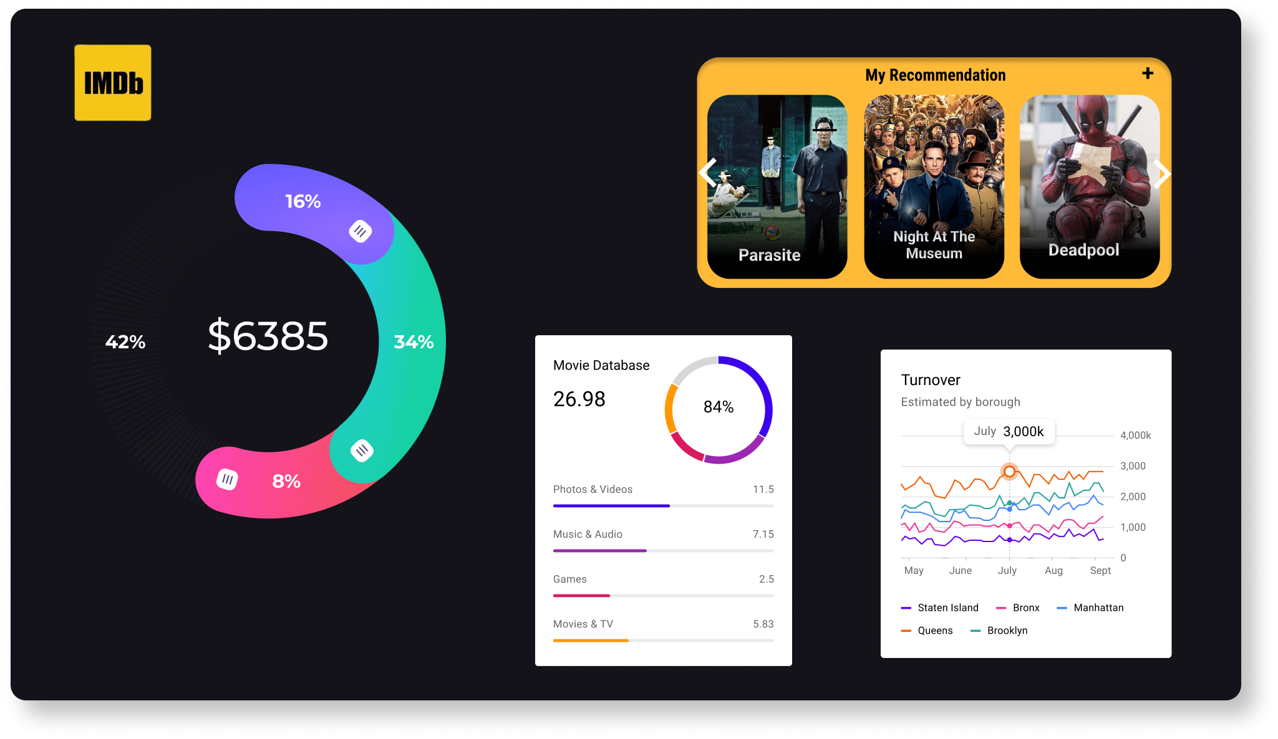
IMDB Movie Analysis
Sumeet Dutta

Slide 2
Contents
Project Description
Project Approach
Tech-Stack Used
Objectives
Insights
Results

Slide 3
Project Description
The aim of this project is to analyze and understand the dataset which is related to IMDB movies and to derive actionable insights that can help stakeholder make informed decision. This dataset contains information about movies, such as name of the director, name of the movie, budget, gross earning, IMDB scores and many more useful data.

Slide 4
Project approach
This project involves a deep understanding of the data and excel data visualizing tools. This dataset had many anomalies such as missing or blank data, unwanted columns and duplicate rows. Therefore, I made the ready for analysis by deleting the missing rows, unwanted columns and duplicate rows.

Slide 5
Tech-stack used
The tech stack for this project utilizes Microsoft Excel. Excel provides a comprehensive set of functions and tools for data analysis and manipulation, making it best for tasks such as data cleaning, statistical calculations, and extracting insights from datasets. With features like built-in functions, formulas, tables, pivot tables, and charts, Excel enables efficient data processing, trend identification, and visualization. These capabilities allow users to explore and interpret data more effectively by using various graphical representations and statistical methods.

Slide 6
Objectives
Task 1: Analyze the distribution of movie genres and their impact on the IMDB score.
Task 2: Analyze the distribution of movie durations and its impact on the IMDB score.
Task 3: Examine the distribution of movies based on their language.
Task 4: Influence of directors on movie ratings.
Task 5: Explore the relationship between movie budgets and their financial success.

Slide 7
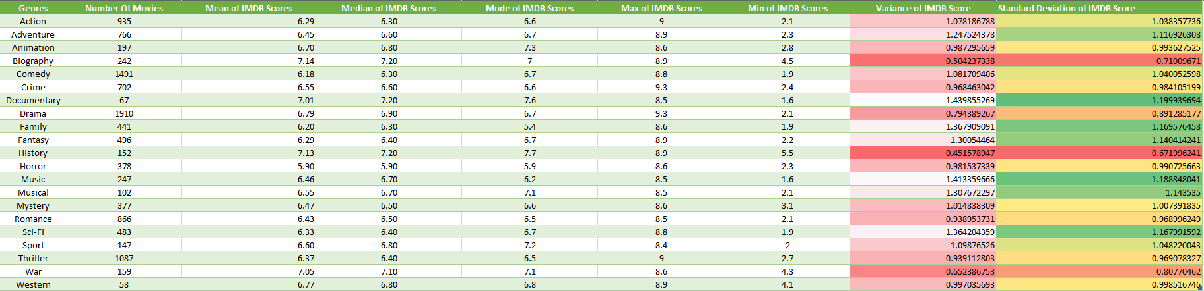
Task 1: Movie Genre Analysis
Task: Determine the most common genres of movies in the dataset.
The most common movies in the dataset are Drama with the highest number of 1910 movies followed by Comedy (1491) and Thriller(1087).

Slide 11
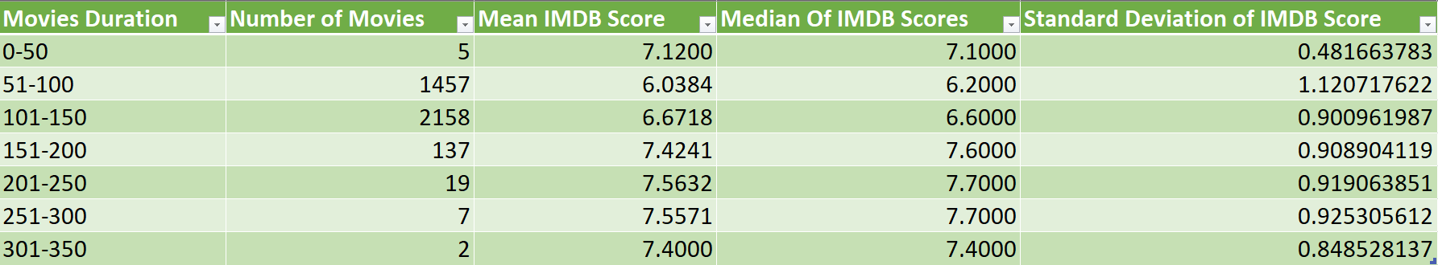
Task 2: Movie Duration Analysis
Task: Analyze the distribution of movie durations and identify the relationship between movie duration and IMDB score.
The movies with the most watch time lies between 101-150 minutes (2158), but their mean and median IMDB score are less compared to the movies with the watch time of 201-250 minutes (19) and they also have the highest mean median of IMDB score.

Slide 12
The trend line of the Movies Duration and the mean and median is a upward slope with a R2 of 0.4214 and 0.4353 respectively

Slide 13
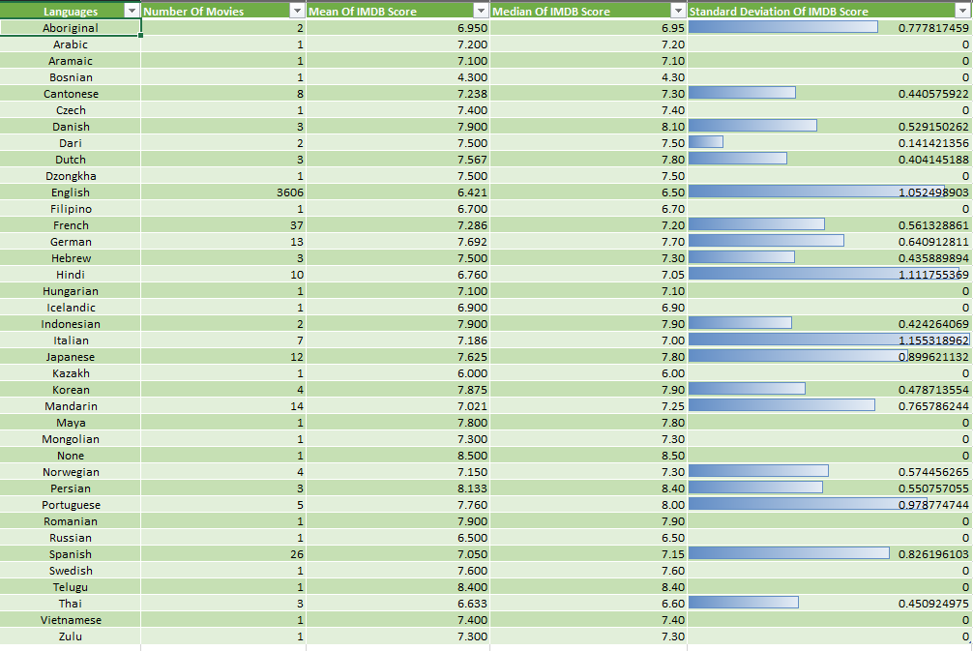
Task 3: Language Analysis

Slide 14
Task: Determine the most common languages used in movies and analyze their impact on the IMDB score using descriptive statistics.
English has the most number of movies which is 3606 but its overall mean of IMDB scores in less compared to other languages, but because the number is considerably high compared to other languages and none of the other language come close to it we say that the mean IMDB score is justified.

Slide 16
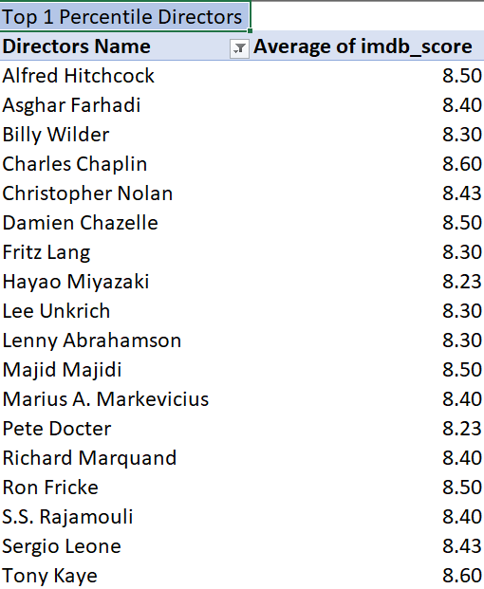
Task 4: Director Analysis
Task: Identify the top directors based on their average IMDB score and analyze their contribution to the success of movies using percentile calculations.
The gap of mean and median IMDB Scores between top 1 percentile director’s and other director’s is very high and they also have a huge gap between the mean and median IMDB Score of all the director’s which is 6.315819638 and 6.457142857 respectively.

Slide 18
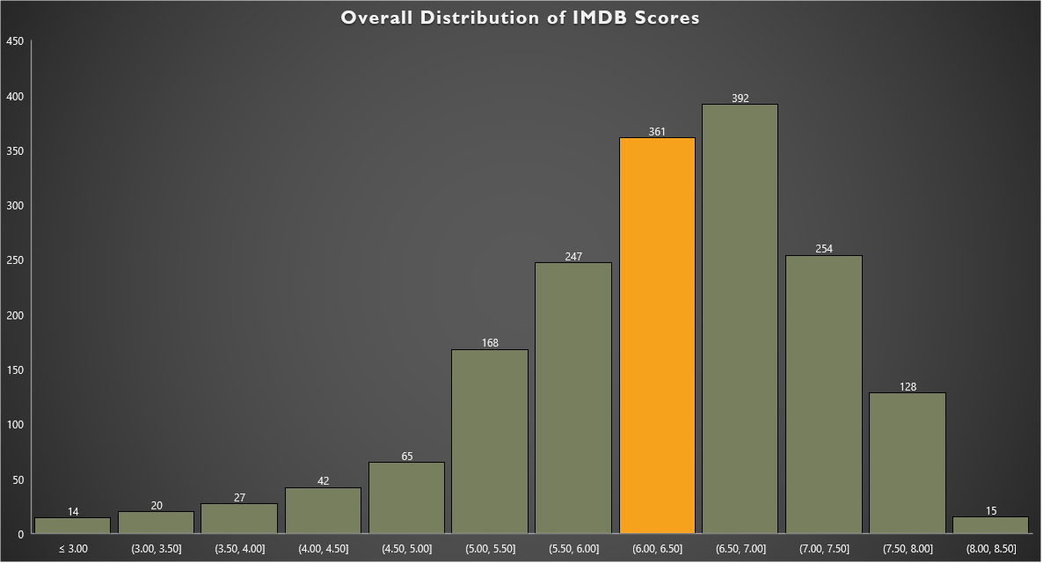
Average IMDB Score of all the Director

Slide 19
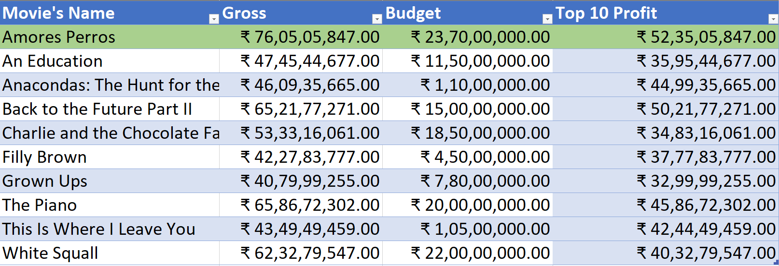
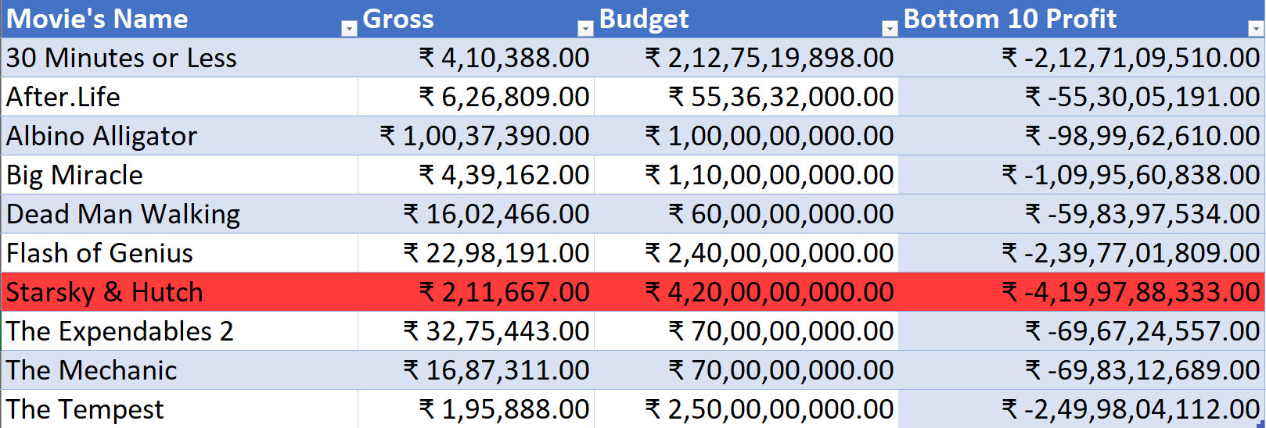
Task 5: Budget Analysis
Task: Analyze the correlation between movie budgets and gross earnings, and identify the movies with the highest profit margin.
The correlation coefficient between movie budgets and gross earnings is positive (0.223115594) and the movie with the highest profit is Amores Perros with the total amount of 52,35,05,847.

Slide 23
Results
In this project, I analyzed IMDB movie data using Microsoft Excel, focusing on IMDB scores, budgets, gross earnings, movies, languages, watch time of the movie and genres to uncover trends. Key tasks included calculating average, median, mode, and standard deviation of IMDB scores, performing correlation analysis between budgets and gross earnings, and identifying top directors using percentile rankings. I also visualized these insights with charts.
This project improved my understanding of how factors like budget, genre, and language impact movie performance, while enhancing my skills in Excel-based data analysis and visualization.

Slide 24
Thank you
Link to the dataset:
https://docs.google.com/spreadsheets/d/1YOizHsabpNTmhAQMZvMWbmTixvZboopM/edit?usp=sharing&ouid=100462539858177935973&rtpof=true&sd=true

